Slide 1


Amazon Sales Analysis
Capstone project

Slide 2
Overview of Amazon Company
Amazon was founded by Jeff Bezos on July 5, 1994.
Initially launched as an online bookstore,
Amazon has since evolved into one of the largest e-commerce and cloud computing
Companies in the world
The company's headquarters are located in Seattle, Washington.

Slide 3
project Overview
Objective: Gain insights into Amazon's sales data.
Branches Analyzed: Mandalay, Yangon, and Naypyitaw.
Data Focus: Product, sales, and customer data.
New Columns Added:
Day name: Day of the week for each transaction
Timeofday: Part of the day when the transaction occurred (Morning, Afternoon, Evening).
Monthname: Month of the year during which the transaction took place.
Aim: Identify factors that influence sales performance across different branches.

Slide 4
Data description
Column | Description | Data Type
invoice | Invoice of the sales made | VARCHAR(30)
branch | Branch at which sales were made | VARCHAR(5)
city | The location of the branch | VARCHAR(30)
customer_type | The type of the customer | VARCHAR(30)
gender | Gender of the customer making purchase | VARCHAR(10)
product_line | Product line of the product sold | VARCHAR(100)
unit_price | The price of each product | DECIMAL(10, 2)
quantity | The amount of the product sold | INT
VAT | The amount of tax on the purchase | FLOAT(6, 4)
total | The total cost of the purchase | DECIMAL(10, 2)
date | The date on which the purchase was made | DATE
time | The time at which the purchase was made | TIMESTAMP
payment_method | The total amount paid | DECIMAL(10, 2)
cogs | Cost Of Goods sold | DECIMAL(10, 2)
gross_margin_percentage | Gross margin percentage | FLOAT(11, 9)
gross_income | Gross Income | DECIMAL(10, 2)
rating | Rating

Slide 5
Product analysis
Best-Selling Product Lines: Highlight product lines with the highest revenue and quantity sold.
Gender Preferences: Show which product lines are favored by different genders.
Average Ratings: Present the average ratings for each product line.
Best Timing for Sales: Identify the best times of day for maximizing sales and revenue.

Slide 6
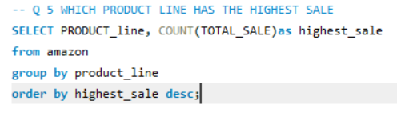
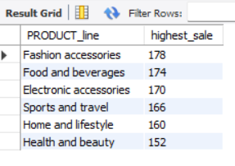
Product analysis
Fashion and Accessories
Food and Beverages
Electronic Accessories
Sports and Travel
Home and Lifestyle
Health and Beauty
There are 6 product line in the data set

Slide 7
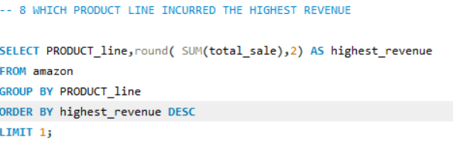
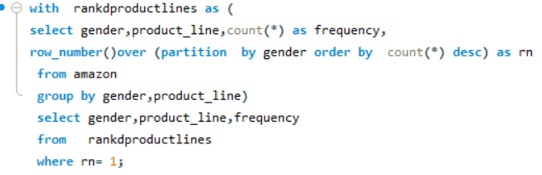
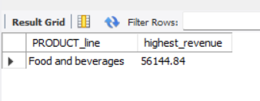
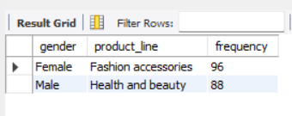
PRODUCT ANALYSIS
Food and Beverages: The highest revenue category, generating ₹56,144.84
Health and Beauty: The lowest revenue category, with ₹49,193.74
Fashion Accessories*: Female customers purchase these items with high frequency.

Slide 8

SALES ANAlysis
1. Monthly Sales Overview:
- January: Highest sales 110,754,
- March: Sales recorded 104,243,
- February: Lowest sales 92,589,
2. Branch-Wise Revenue:
- Naypyitaw: Achieved the highest revenue with 110,568 units sold.
- Yangon: Recorded 106,200 units in revenue.
- Mandalay: Slightly lower, with 106,197 units in revenue.
3. Sales Insights:
- Highest occurrence of sales recorded during evening hours across all branches.
- Payment method E-wallet

Slide 9

Customer analysis
Customer Type Analysis:
1.Identify Customer Types: Divide customers into 'Member' and 'Normal' categories.
2.Top Product Purchases: Determine which customer type buys the most products.
Gender Distribution per Branch:
1.Gender Breakdown: Analyze the gender distribution (Male/Female) across different branches.
2.Customer Type by Gender: Further segment this data by customer type (Member vs. Normal) to
understand which gender prefers which type of membership
Payment Method preferred
RATING

Slide 10
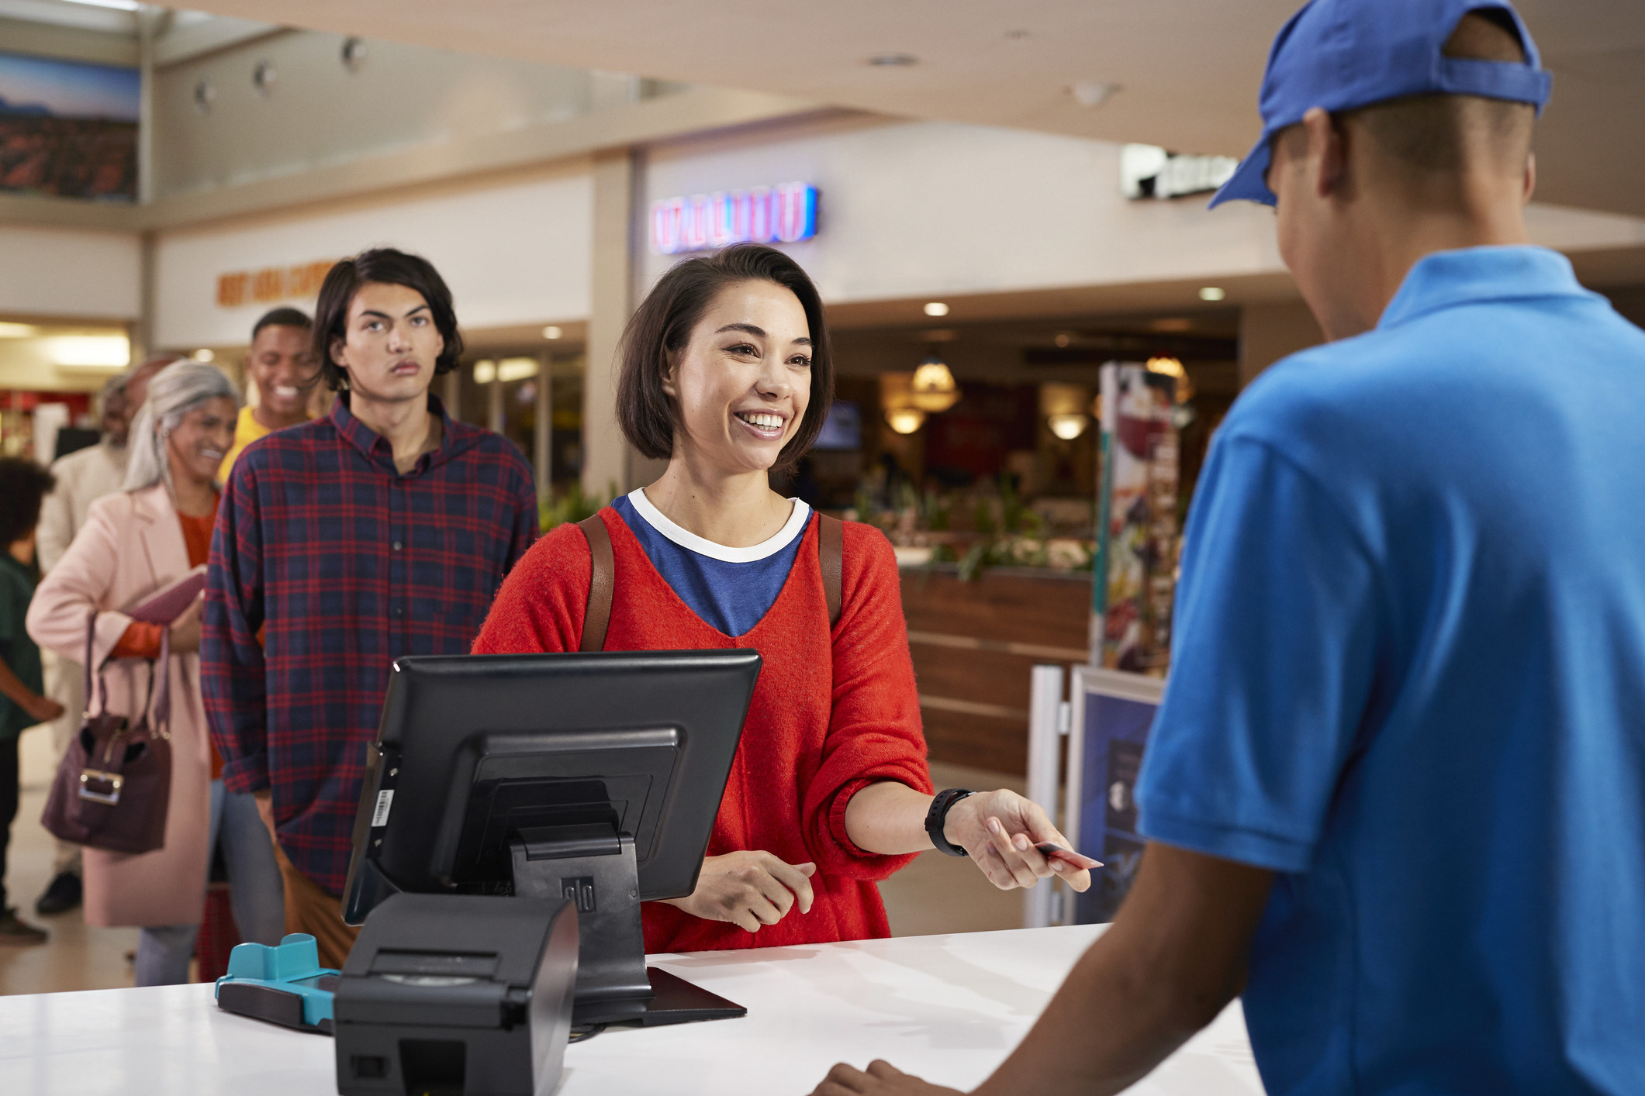
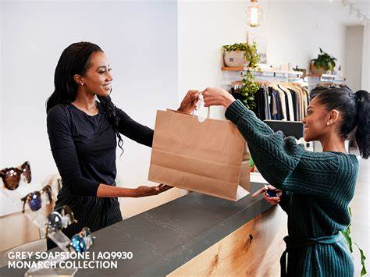
Customer analysis
Customer Type Distribution:
Member Customers: 501
Normal Customers: 499
Purchase and VAT Analysis:
Highest Purchase:
Member Customers: ₹164,233
Normal Customers: ₹158,743
VAT Payments:
Member Customers: 15.61%
Normal Customers: 15.15%

Slide 11
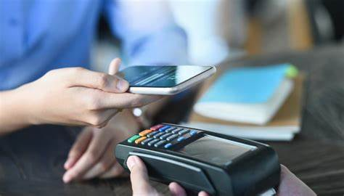
Customer analysis
Customer Ratings
Time of Day:
Afternoon: Most ratings provided
Branch-wise Ratings
Branch A: Highest ratings in the afternoon
Branch B: Highest ratings in the morning
Branch C: Highest ratings in the evening
Ratings by Weekday
Branch A: Friday - 7.31
Branch B: Monday - 7.34
Branch C: Friday - 7.28
Payment Methods Preferred
E-Wallet

Slide 12
RECOMMENDATION
Promote membership programs.
Optimize rating collection.
Enhance e-wallet promotions.
Tailor marketing strategies by branch.
Monitor and adjust VAT impact.
Focus on health and beauty sales in Mandalay and Yangon branches.
Offer discounts and promotions on key products to boost sales across all branches

